Slide 1
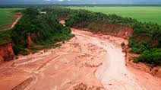


Integrated Sediment Transport Management in Jucar River Basin, Spain

Slide 2
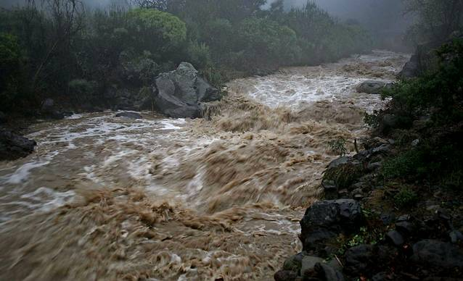
Sediment Transport Management in Jucar River Basin, Spain
Introduction to sediment transport in rivers
Obstacles to sediment transport
Case studies to regulate river sediments
Conclusions
1
2
3
4
Notes:
B: Then we’ll move on with a couple of case studies and see who collaboration with different social agents/stakeholders is vital in this process

Slide 3
Sediment Transport Management in Jucar River Basin, Spain
Introduction to sediment transport in rivers
Obstacles to sediment transport
Case studies to regulate river sediments
Conclusions
1
2
3
4
Notes:
B: Then we’ll move on with a couple of case studies and see who collaboration with different social agents/stakeholders is vital in this process

Slide 4
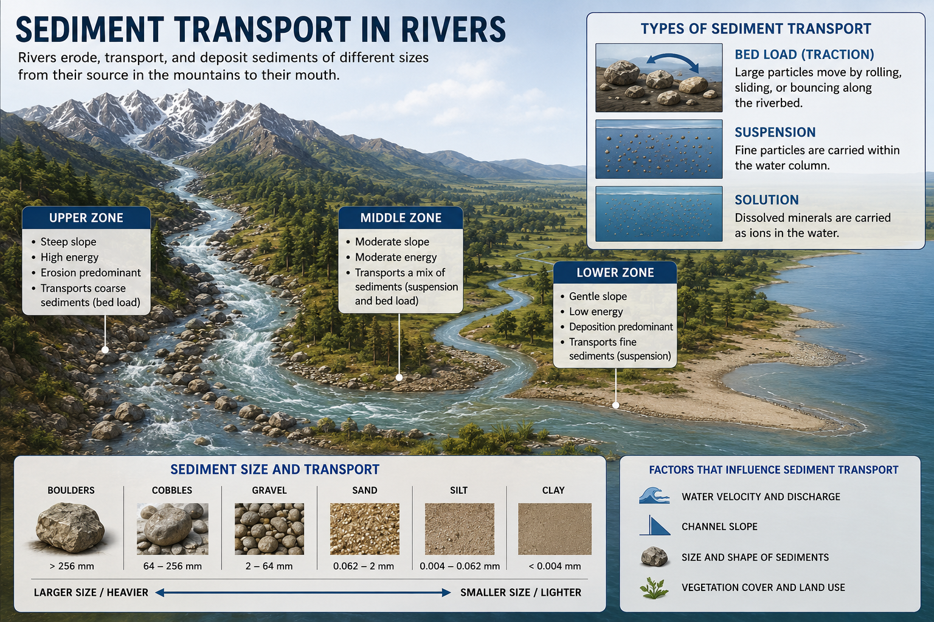
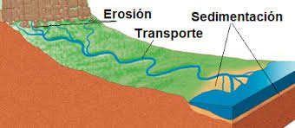
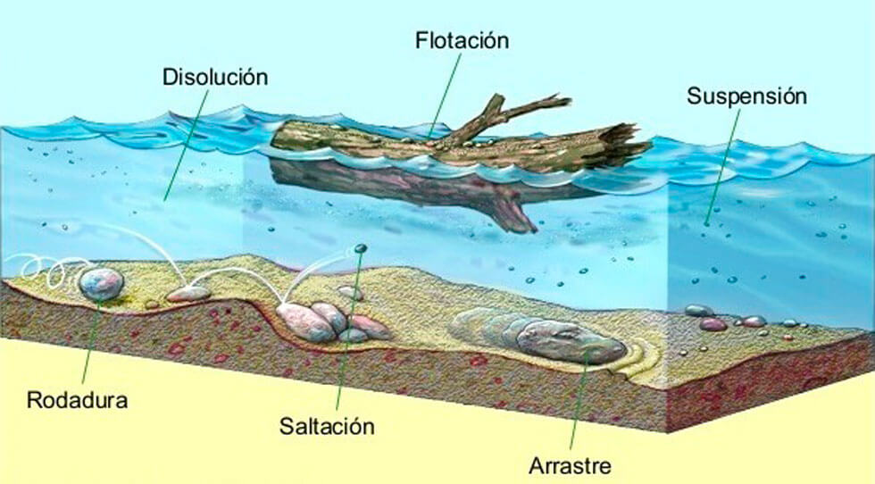


Slide 5
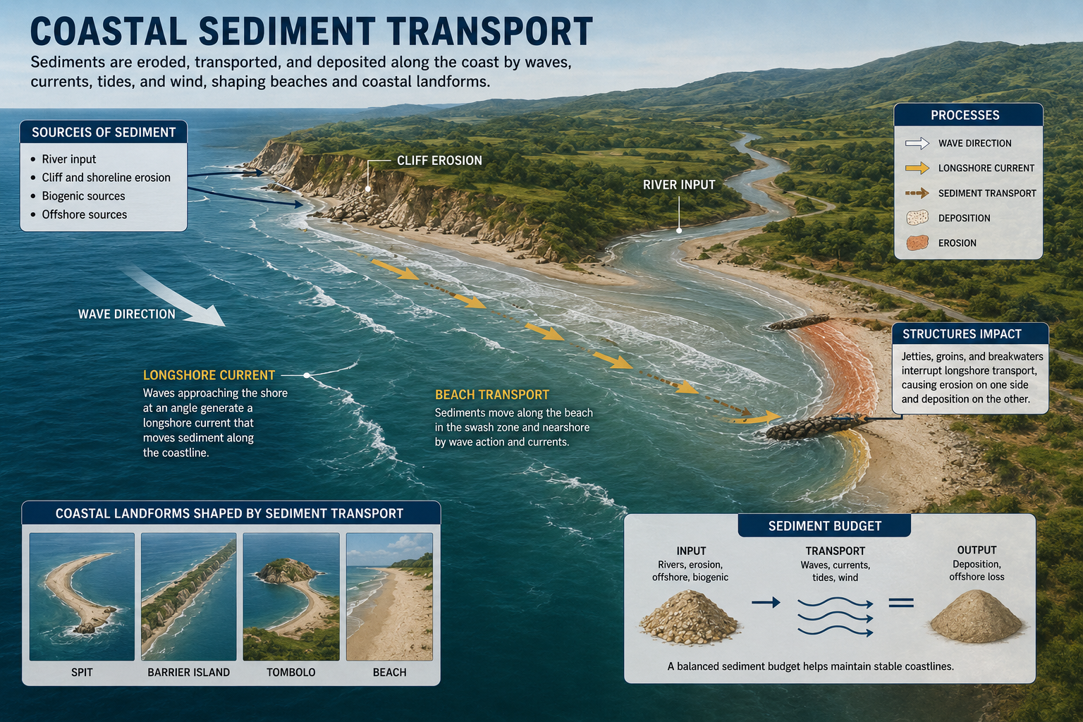

Slide 6
Sediment Transport Management in Jucar River Basin, Spain
Introduction to sediment transport in rivers
Obstacles to sediment transport
Case studies to regulate river sediments
Conclusions
1
2
3
4
Notes:
B: Then we’ll move on with a couple of case studies and see who collaboration with different social agents/stakeholders is vital in this process

Slide 7
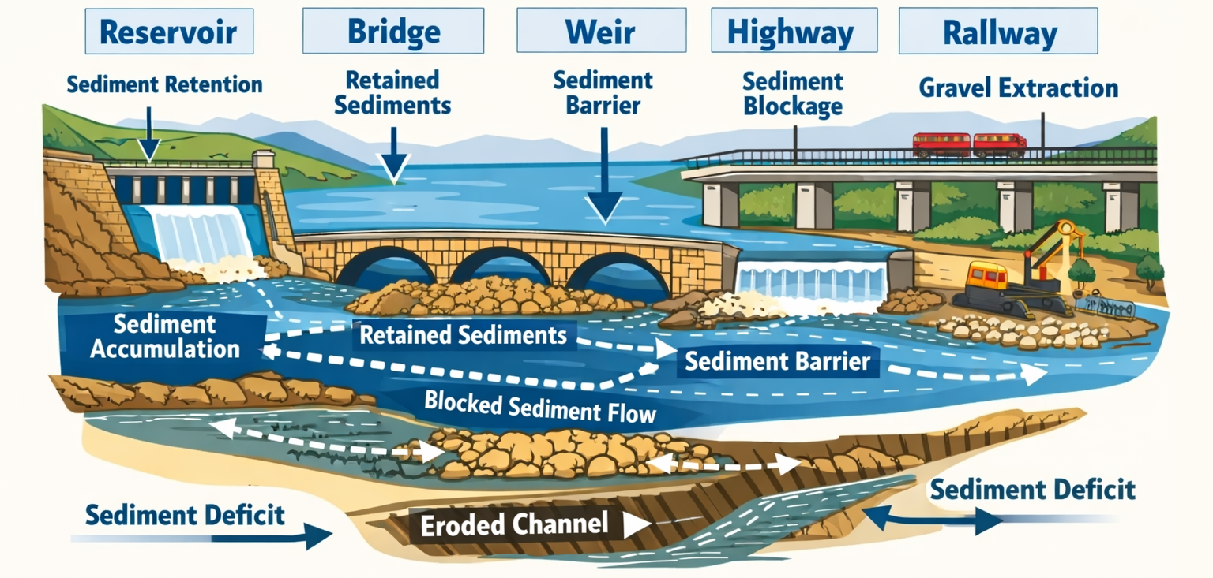
Obstacles to Sediment Transport in Rivers
Sediment Transport Management in Jucar River Basin, Spain

Slide 8
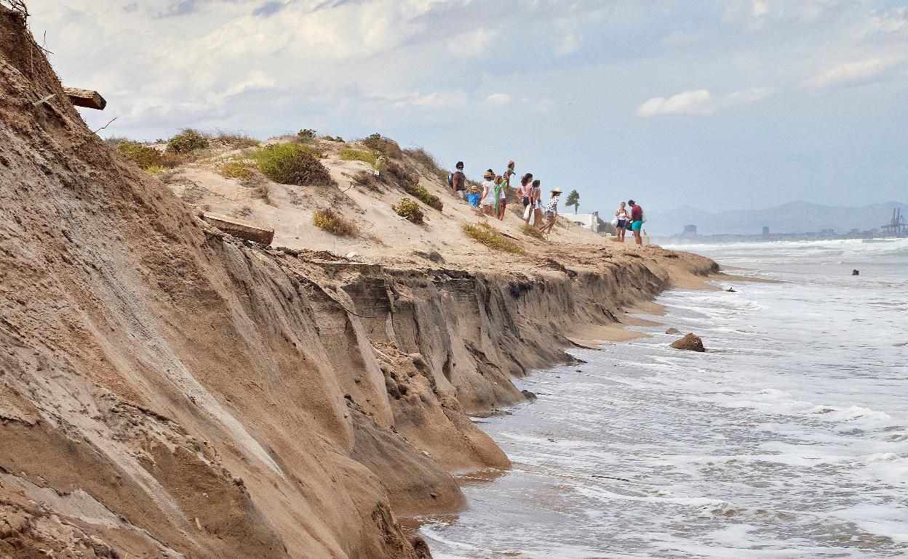
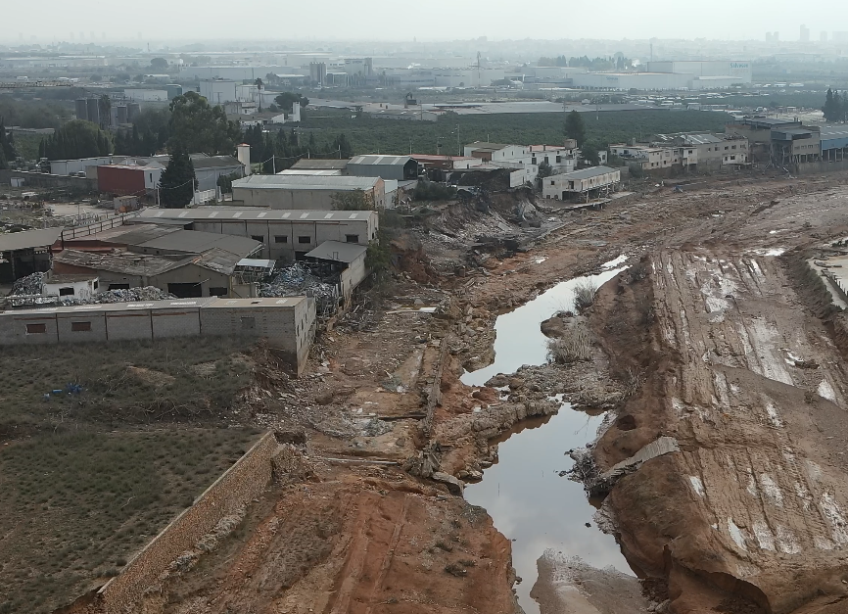


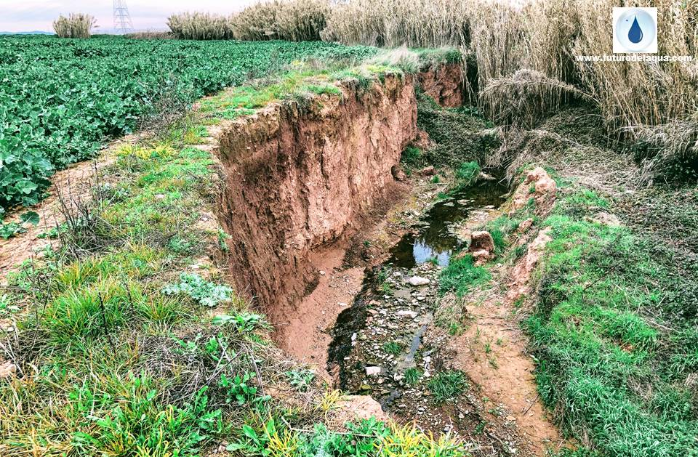
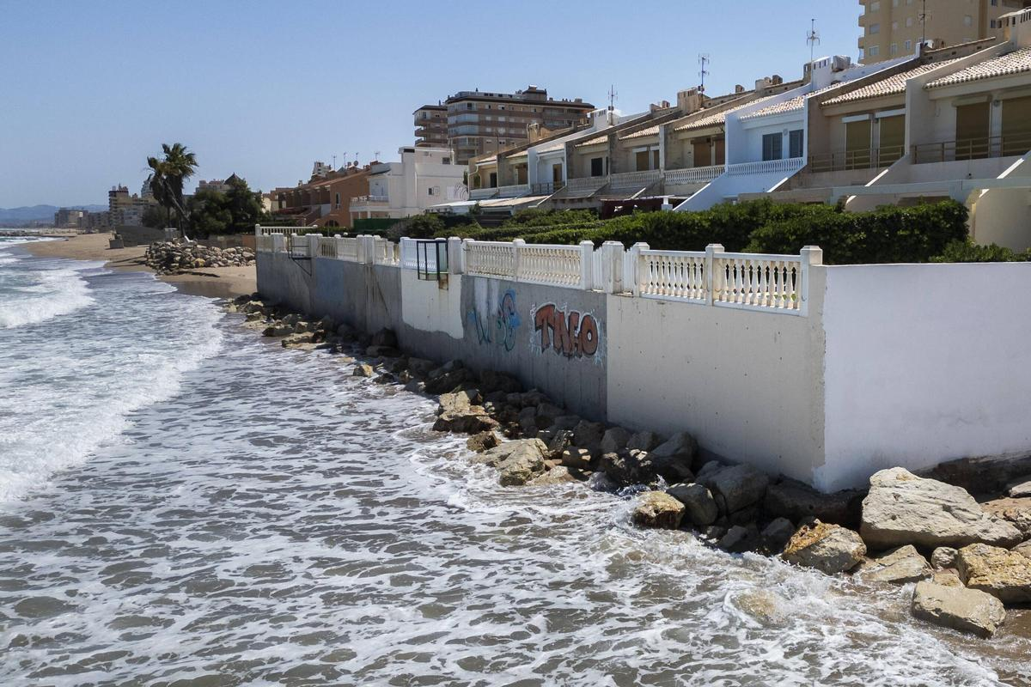
Obstacles to Sediment Transport in Rivers
Rivers and coasts are HUNGRY for sediments

Slide 9
Sediment Transport Management in Jucar River Basin, Spain
Introduction to sediment transport in rivers
Obstacles to sediment transport
Case studies to regulate river sediments
Conclusions
1
2
3
4
Notes:
B: Then we’ll move on with a couple of case studies and see who collaboration with different social agents/stakeholders is vital in this process

Slide 10





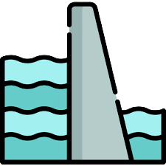

Water Basin Plan – Law Regulation
Aggregate extraction is prohibited by default
Sediments only purpose is for the river and marine dynamics
Only allowed where there are existing barriers for solid transport (weirs, dams)
Always with authorization: control where, when and how
Water Authority keeps inventory of all river areas where earth extraction is allowed

Slide 11
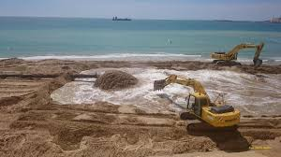


Protocol between River-Coast Authorities
Temporary rivers in region.
Infrastructures limit or prevent free Flow of sediments downstream
Dams and weirs reduce the volume of sediments that reach the coast
Sediments in reservoirs reduce storage capacity and efficiency
Reduction of river sediments input threatens marine ecosystems

Slide 12
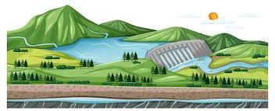

Water Basin Plan – Law Regulation
Basin Authority identify potential areas for aggregate extraction.
Marine authority proposes area and undertakes extraction
ONLY for environmental purposes
Transport of sediments from reservoirs to coastal renovation projects
Works during dry season with minimal environmental impact
No trees cutting

Slide 13

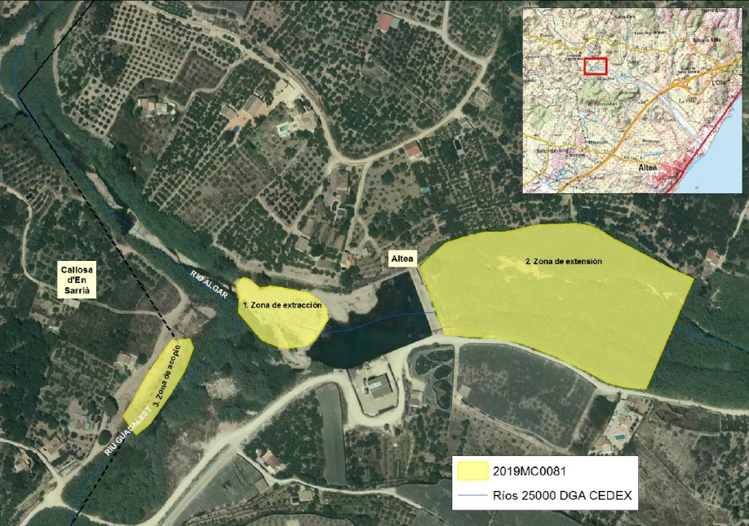
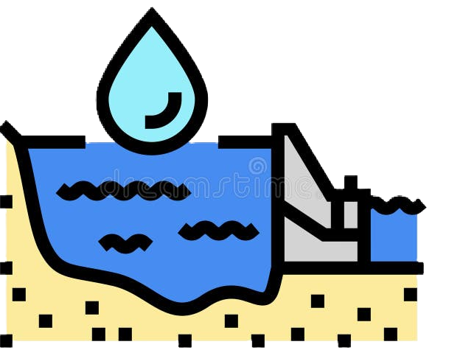


Authorization of river extraction in river Algar weir
Authorization of river extraction in weirs
30 years soil accumulation MUST NOT be released in one year
Only 20% of material is placed downstream, 80% waste manager facility
GRADUAL soil placement before rainy season
Material stockpiling in long thin strips
Monitoring macroinvertebrate

Slide 14
Sediment Transport Management in Jucar River Basin, Spain
Introduction to sediment transport in rivers
Obstacles to sediment transport
Case studies to regulate river sediments
Conclusions
1
2
3
4
Notes:
B: Then we’ll move on with a couple of case studies and see who collaboration with different social agents/stakeholders is vital in this process

Slide 15

Conclusions
Sediment management at a basin scale: river and coast
Be realistic. Return to unaltered river system is not posible. Adaptation is vital.
Include sediment by-pass in dams and weirs as part of its maintenance costs
Many Stockholders. Need for stronger Colaboration
New regulations: simplify burocrazy

Slide 16
Integrated Sediment Transport Management in Jucar River Basin, Spain
Thank you for your attention

